Slide 1
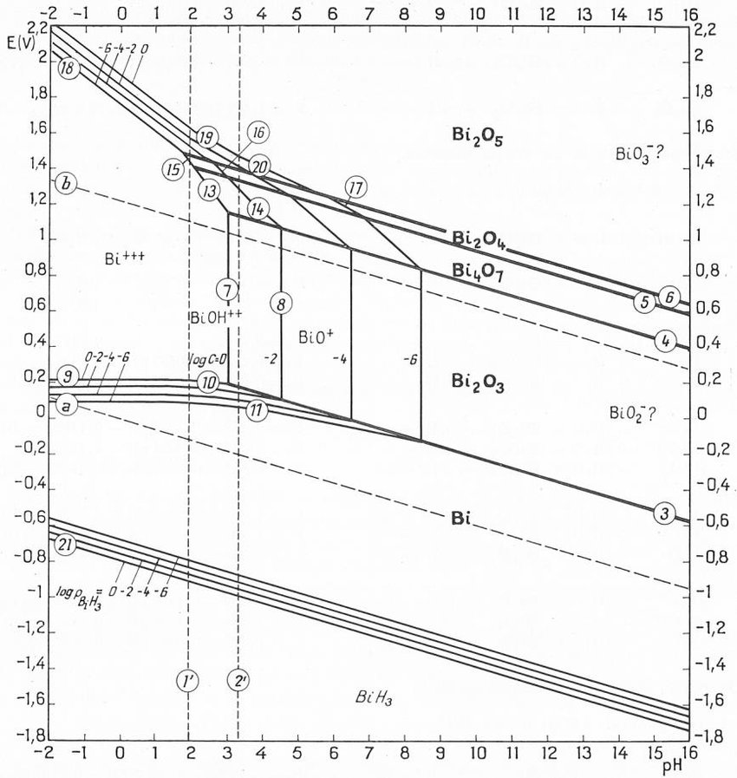
Exercise1: Pourbaix diagram
You want to electrodeposit bismuth from an aqueous electrolyte and you want to choose the ideal conditions.
You decide to refer to the E-pH thermodynamic equilibriums found in Pourbaix diagram.
You find the Pourbaix diagram for Bi³⁺ in pure water at ambient conditions:
4
5
3
1
2
6
What represent the vertical, horizontal, and diagonal lines. What are their duplicated lines?
What are the diagonal dashed lines? Write the reactions? Name the space defined between them.
Write the reactions that occur at the transitions 1, 2, 3, 4, 5, and 6
Calculate their slope in the E-pH domain.
From the Pourbaix diagram, propose boundary conditions on E, pH and [Bi³⁺] for the electrodeposition of Bi⁰

Slide 2
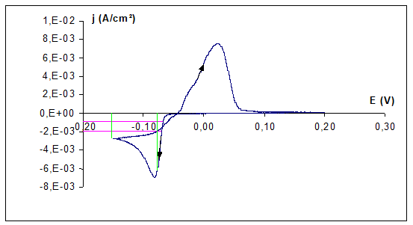
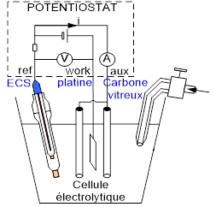
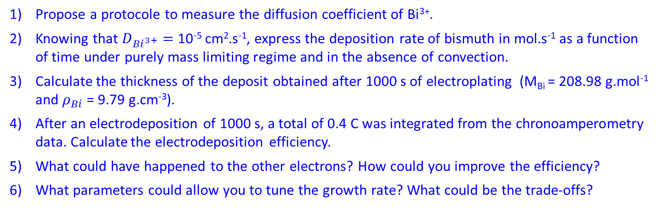
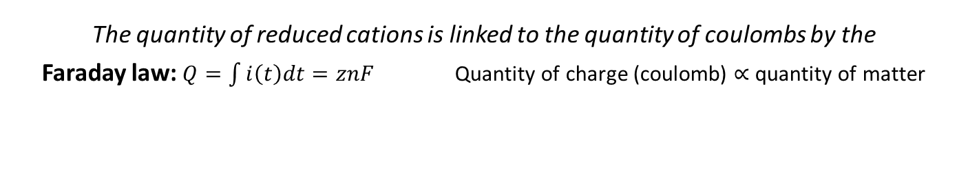
Exercise2: electrodeposition rate and current efficiency
The quantity of reduced cations is linked to the quantity of coulombs by the
Faraday law: $Q=\int{i\left(t\right)dt=znF}$ Quantity of charge (coulomb) $∝$ quantity of matter
Faraday constant $F=q𝒩_{A}=96485 C.{mol}^{−1}$
Bismuth is electrodeposited from a degased aqueous electrolyte ([Bi³⁺] = 10⁻² mol.L⁻¹, [HNO₃] = 1 M) on an 1 cm² working electrode at a sufficiently large overpotential
Argon
Propose a protocole to measure the diffusion coefficient of Bi³⁺.
Knowing that $D_{{Bi}^{3+}}=$ 10⁻⁵ cm².s⁻¹, express the deposition rate of bismuth in mol.s⁻¹ as a function of time under purely mass limiting regime and in the absence of convection.
Calculate the thickness of the deposit obtained after 1000 s of electroplating (M_{Bi} = 208.98 g.mol⁻¹ and $ρ_{Bi}$ = 9.79 g.cm⁻³).
After an electrodeposition of 1000 s, a total of 0.4 C was integrated from the chronoamperometry data. Calculate the electrodeposition efficiency.
What could have happened to the other electrons? How could you improve the efficiency?
What parameters could allow you to tune the growth rate? What could be the trade-offs?

